Slide 1
Introduction to Robotics
Course no. 10
Andrei Dumitriu
andrei.dumitriu@fmi.unibuc.ro
Faculty of Mathematics and Computer Science
University of Bucharest

Slide 2
Today’s highlights
Electronics: diodes & transistors
DC motors
H-Bridges
DC motor drivers: L293D
Open Loop vs Closed Loop
Servo Motors
Stepper Motors
Attendance / Q&A

Slide 3
Electronics: Diodes
What is a diode?

Slide 4
Electronics: Diodes
What is a diode?
A diode is a two-terminal electronic component that conducts current primarily in one direction (asymmetric conductance); it has low (ideally zero) resistance in one direction, and high (ideally infinite) resistance in the other.
Short version: a semiconductor that allows current to flow only one one way.
What types of diodes can you name? Which ones have we used?

Slide 5
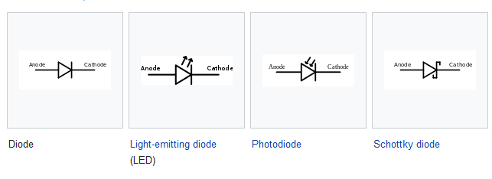
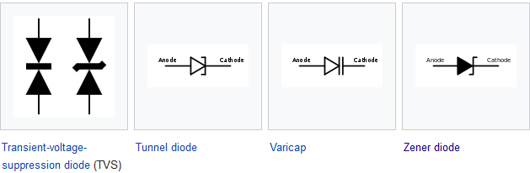
Electronics: Diodes
What types of diodes can you name? Which ones have we used?

Slide 6
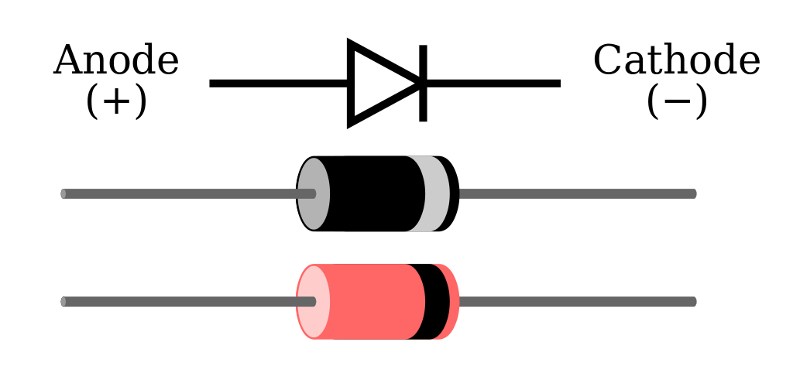
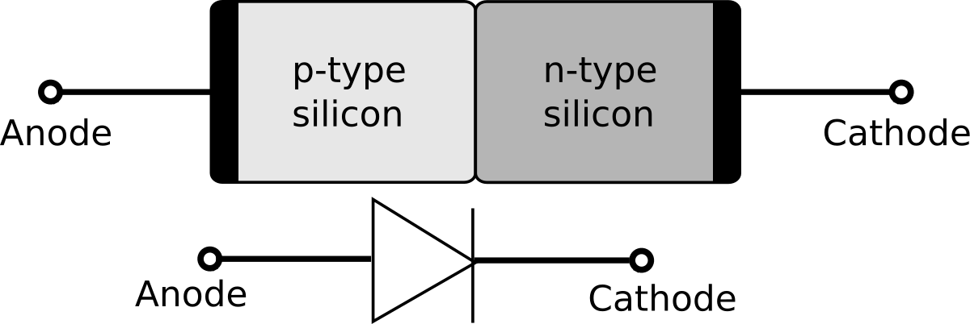
Electronics: Diodes
What types of diodes can you name? Which ones have we used?
As you saw, there are many types (and those aren’t even all), but we mainly used 2 of them
P-N diode (but we’ll just refer to it simply as Diode)
LED (Light Emitting Diode)
Honorable mentions: Zener diode

Slide 7
Electronics: Diodes
Zener diode type of diode that allows current to flow in the conventional manner - from its anode to its cathode i.e. when the anode is positive with respect to the cathode. When the voltage across the terminals is reversed and the potential reaches the Zener voltage (or "knee"), the junction will breakdown and current will flow in the reverse direction - a desired characteristic. This effect is known as the Zener effect, after Clarence Zener, who first described the phenomenon. Zener diodes are manufactured with a great variety of Zener voltages (Vz) and some are even variable. (wikipedia ftw)
Zener diodes have a highly doped p–n junction. A similar breakdown is observed in general purpose diodes (which might be quite high), but the voltage and sharpness of the knee is not clearly defined as in Zener diodes. Normal diodes are not designed to operate in the breakdown region and it can cause permanent failure of the device.

Slide 8
Electronics: Transistors
Earlier we saw that simple diodes are made up from two pieces of semiconductor material to form a simple pn-junction and we also learnt about their properties and characteristics.
What happens if we join two diodes together?

Slide 9
Electronics: Transistors
Earlier we saw that simple diodes are made up from two pieces of semiconductor material to form a simple pn-junction and we also learnt about their properties and characteristics.
What happens if we join two diodes together?
It will give us two PN-junctions connected together in series that share a common P or N terminal. The fusion of these two diodes produces a three layer, two junction, three terminal device forming the basis of a Bipolar Junction Transistor, or BJT for short.

Slide 10
Electronics: Transistors
Earlier we saw that simple diodes are made up from two pieces of semiconductor material to form a simple pn-junction and we also learnt about their properties and characteristics.
What happens if we join two diodes together?
It will give us two PN-junctions connected together in series that share a common P or N terminal. The fusion of these two diodes produces a three layer, two junction, three terminal device forming the basis of a Bipolar Junction Transistor, or BJT for short.
Transistors are three terminal active devices made from different semiconductor materials that can act as either an insulator or a conductor by the application of a small signal voltage. The transistor’s ability to change between these two states enables it to have two basic functions: “switching” (digital electronics) or “amplification” (analogue electronics).

Slide 11
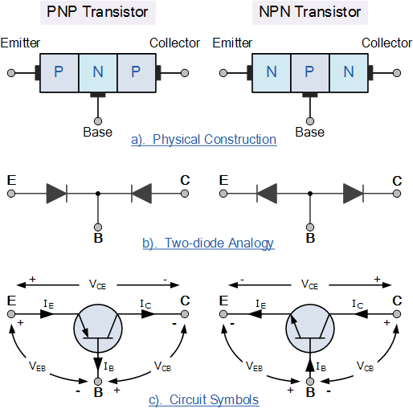
Electronics: Transistors
The construction and circuit symbols for both the PNP and NPN bipolar transistor are given to the right with the arrow in the circuit symbol always showing the direction of “conventional current flow” between the base terminal and its emitter terminal. The direction of the arrow always points from the positive P-type region to the negative N-type region for both transistor types, exactly the same as for the standard diode symbol.

Slide 12
Electronics: Transistors
The bipolar transistors have the ability to operate within three different regions:
Active Region – the transistor operates as an amplifier and Ic = β*Ib
Saturation – the transistor is “Fully-ON” operating as a switch and Ic = I(saturation)
Cut-off – the transistor is “Fully-OFF” operating as a switch and Ic = 0
The word Transistor is a combination of the two words Transfer Varistor which describes their mode of operation way back in their early days of electronics development.
The Bipolar Transistor basic construction consists of two PN-junctions producing three connecting terminals with each terminal being given a name to identify it from the other two. These three terminals are known and labelled as the Emitter ( E ), the Base ( B ) and the Collector ( C ) respectively.

Slide 13
Electronics: Transistors
Bipolar Transistors are current regulating devices that control the amount of current flowing through them from the Emitter to the Collector terminals in proportion to the amount of biasing voltage applied to their base terminal, thus acting like a current-controlled switch. As a small current flowing into the base terminal controls a much larger collector current forming the basis of transistor action.
The principle of operation of the two transistor types PNP and NPN, is exactly the same the only difference being in their biasing and the polarity of the power supply for each type.

Slide 14
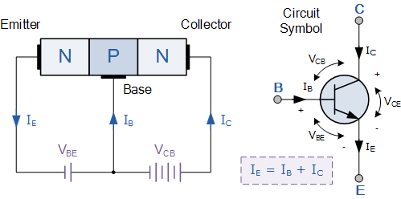
Electronics: NPN Transistors
The most commonly used transistor configuration is the NPN Transistor.
The voltage between the Base and Emitter ( VBE ), is positive at the Base and negative at the Emitter because for an NPN transistor, the Base terminal is always positive with respect to the Emitter. Also the Collector supply voltage is positive with respect to the Emitter ( VCE ). So for a bipolar NPN transistor to conduct the Collector is always more positive with respect to both the Base and the Emitter.
How is this useful?

Slide 15
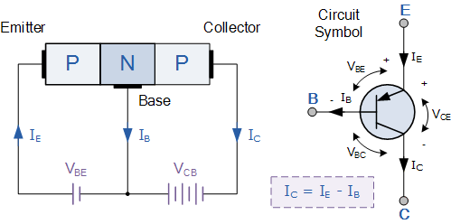
Electronics: PNP Transistors
Basically, in this type of transistor construction the two diodes are reversed with respect to the NPN type giving a Positive-Negative-Positive type of configuration, with the arrow which also defines the Emitter terminal this time pointing inwards in the transistor symbol.
The voltage between the Base and Emitter ( VBE ), is now negative at the Base and positive at the Emitter because for a PNP transistor, the Base terminal is always biased negative with respect to the Emitter.

Slide 16
Electronics: Transistors
What’s the point of having both PNP and NPN, especially since NPN transistors are more commonly used?

Slide 17
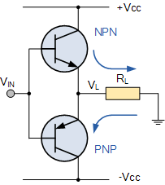
Electronics: Transistors
What’s the point of having both PNP and NPN, especially since NPN transistors are more commonly used?
Having two different types of transistors “PNP” and “NPN”, can be a great advantage when designing power amplifier circuits such as the Class B Amplifier.
Class-B amplifiers uses “Complementary” or “Matched Pair” (that is one PNP and one NPN connected together) transistors in its output stage or in reversible H-Bridge motor control circuits where we want to control the flow of current evenly through the motor in both directions at different times for forward and reverse motion. (more on this in a bit)
Long story short: PNP switches ON by a low signal whereas NPN switches ON by a high signal on base
https://www.youtube.com/watch?v=kNVaIqmKUoI

Slide 18
DC Motors
What is a DC motor?

Slide 19
DC Motors
What is a DC motor?
A DC motor is any of a class of rotary electrical machines that converts direct current electrical energy into mechanical energy.
AKA an electrical machine that converts electrical energy (in our case, DC) into mechanical energy.
How does it work?

Slide 20
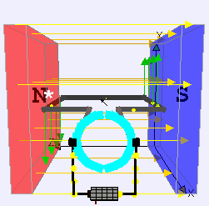
DC Motors
What is a DC motor?
A DC motor is any of a class of rotary electrical machines that converts direct current electrical energy into mechanical energy.
AKA an electrical machine that converts electrical energy (in our case, DC) into mechanical energy.
How does it work?

Slide 21
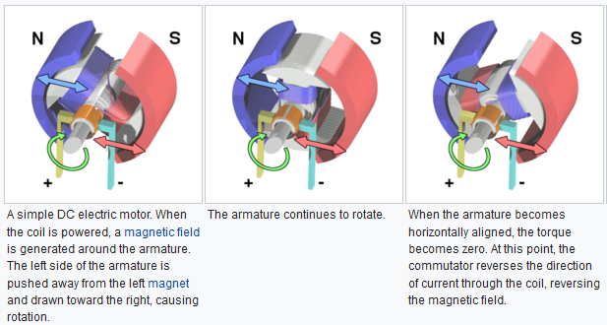
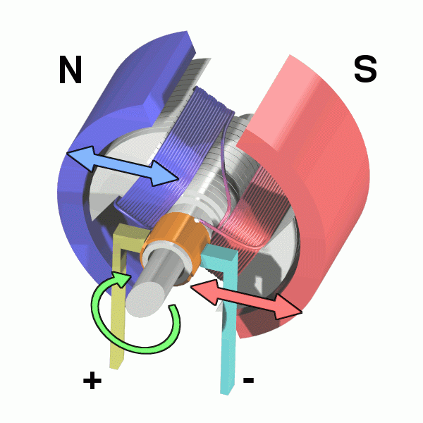
DC Motors
How does it work?

Slide 22
DC Motors
Some problems with this simple design
DC Motor, How it works?

Slide 23
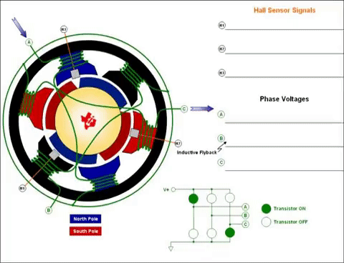
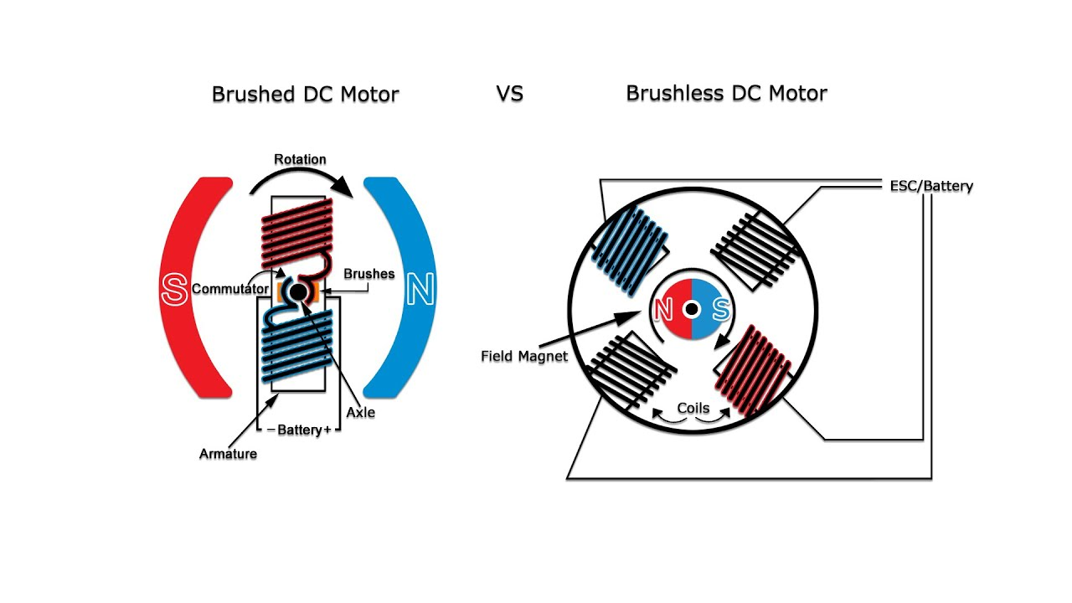
DC Motors (brushless)
The brushes in conventional DC motors use up over time
Brushless are more reliant and produce less noise
The rotor of a brushless DC is a permanent magnet
The brushless DC motor is more expensive!
https://www.youtube.com/watch?v=bCEiOnuODac

Slide 24
DC Motors
All fine, but how do we control one with Arduino?

Slide 25
DC Motors
All fine, but how do we control one with Arduino?
Motor drivers! In this lab, more specifically we use L293D (we also have L298N and L298 v2, btw)
So...what is a motor driver? And why do we use it?
L293, L293D Quadruple Half-H Drivers (Rev. D)

Slide 26
DC Motors
L293d is basically a H-bridge. So...what’s a H-bridge? (remember the NPN and PNP transistors?)

Slide 27
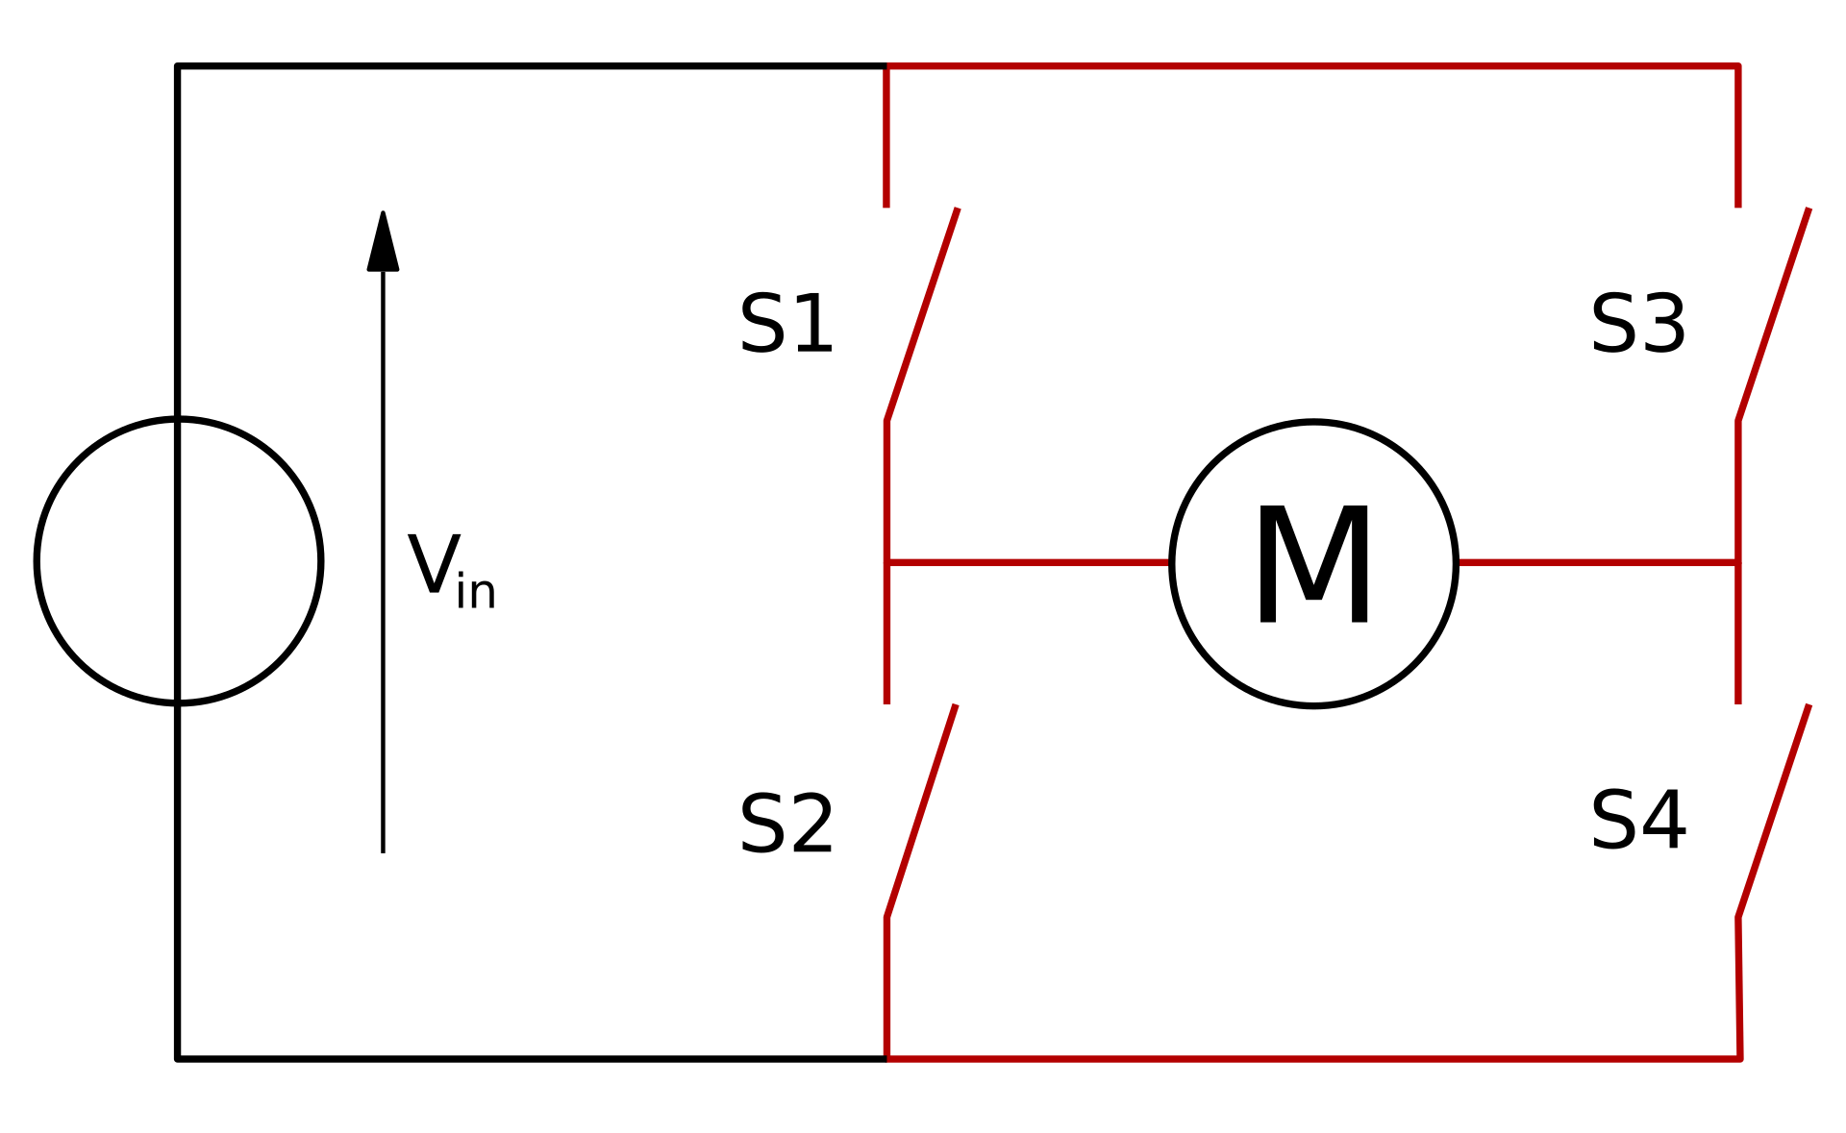
DC Motors
L293d is basically a H-bridge. So...what’s a H-bridge? (remember the NPN and PNP transistors?)
An H bridge is an electronic circuit that switches the polarity of a voltage applied to a load.

Slide 28
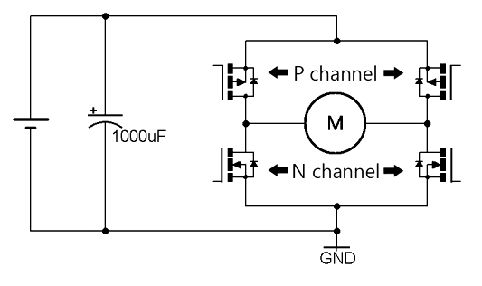
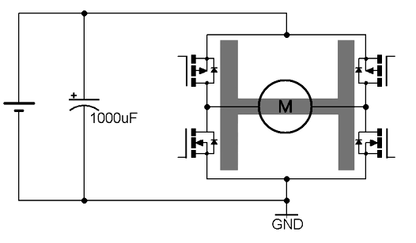
DC Motors
Usually, an H-bridge uses PNP transistors at the “top” and NPN transistors at the “bottom”. This eases the design in order to minimize the risk of short circuiting

Slide 29
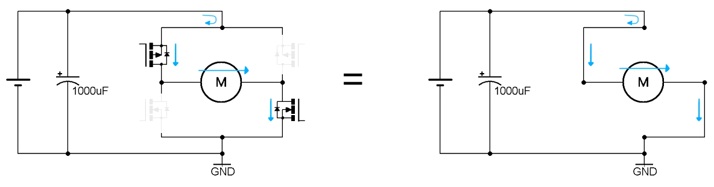
DC Motors
Turning these 2 transistors on and the other 2 off, this will be the equivalent circuit. This will make the motor spin in one direction.
How do we change the direction of the motor?

Slide 30
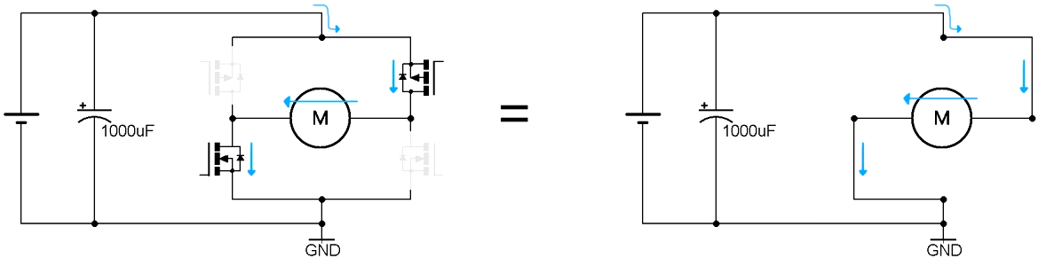
DC Motors
How do we change the direction of the motor?
We reverse the 4 transistors’ state, thus reversing the direction of the current going through the motor

Slide 31
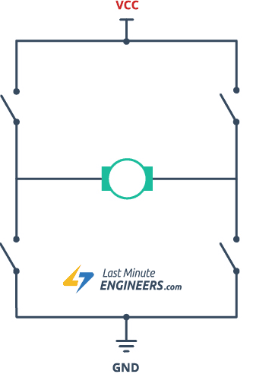
DC Motors
How do we change the direction of the motor?
We reverse the 4 transistors’ state, thus reversing the direction of the current going through the motor

Slide 32
DC Motors
Potential problems?
What happens if we turn all the transistors on?

Slide 33
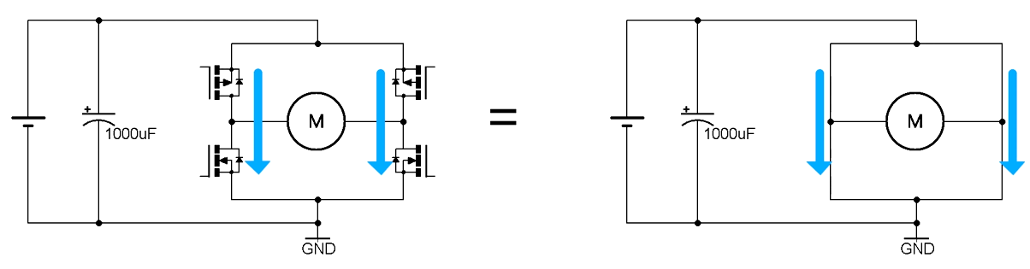
DC Motors
Potential problems?
What happens if we turn all the transistors on?
We create 2 high current paths straight from power to ground, short circuiting the power supply and blowing up the transistors

Slide 34
DC Motors
So, again, why NPN and PNP?

Slide 35
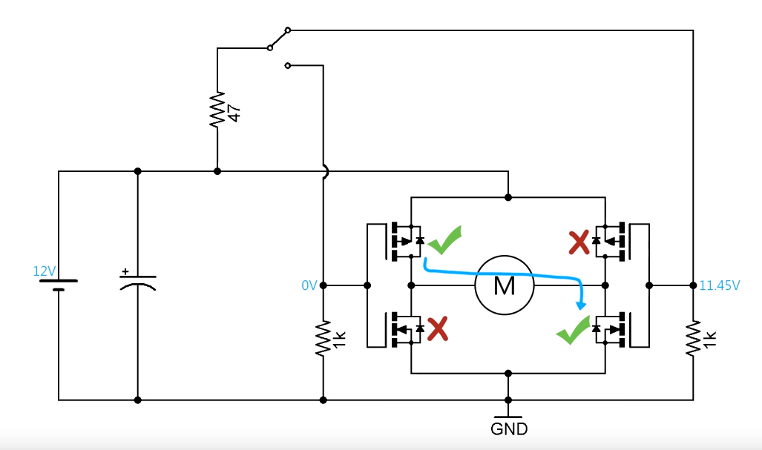
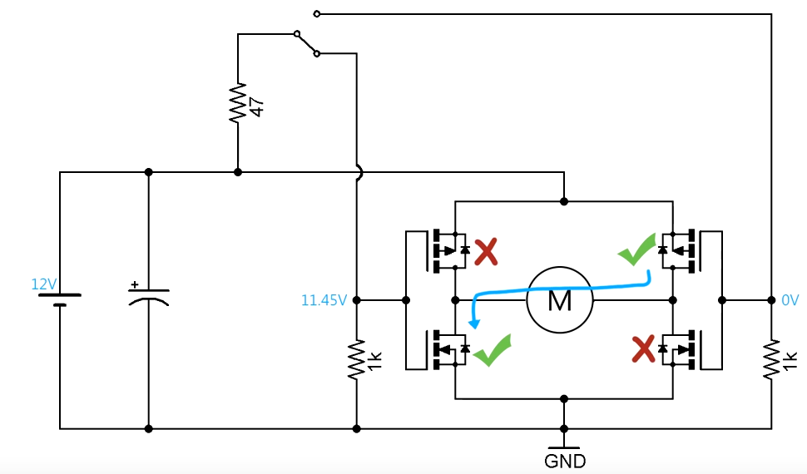
DC Motors
So, again, why NPN and PNP?
Easier to make the design more “idiot proof”

Slide 36
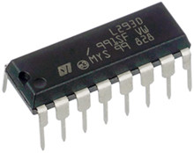
L293D
The L293D is a dual-channel H-Bridge motor driver capable of driving a pair of DC motors or a single stepper motor. This means it can drive up to two motors individually which makes it ideal for building a two-wheeled robotic platform.
The L293D IC has a supply range of 4.5V to 36V and is capable of 1.2A peak output current per channel, so it works very well with most of our motors.

Slide 37
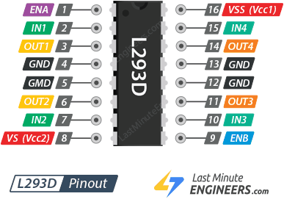
L293D Motor Driver IC Pinout
The L293D IC has a total of 16 pins that connect it to the outside world. The pinout is as follows:

Slide 38
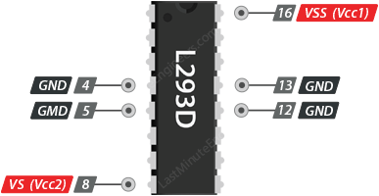
L293D Motor Driver Power Pins
The L293D motor driver IC actually has two input power pins – VS and VSS.
VS (Vcc2) pin gives power to the internal H-Bridge of the IC to drive the motors. You can connect an input voltage anywhere between 4.5 to 36V to this pin.
VSS (Vcc1) is used to drive the internal logic circuitry which should be 5V.
GND pins are common ground pins. All 4 GND pins are internally connected and used to dissipate the heat generated under high load conditions.
!important Do not mix the VCC of the battery with the 5V of the Arduino! VCC1 must be powered with 5v from Arduino, while VCC2 will be powered from the battery (in our case, 7.4v)

Slide 39
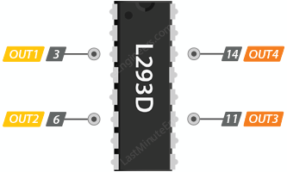
L293D Motor Driver Output Pins
The L293D motor driver’s output channels for the motor A and B are brought out to pins OUT1,OUT2 and OUT3,OUT4 respectively. You can connect two 5-36V DC motors to these pins.
Each channel on the IC can deliver up to 600mA to the DC motor. However, the amount of current supplied to the motor depends on system’s power supply.

Slide 40
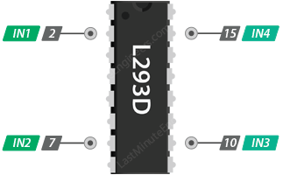
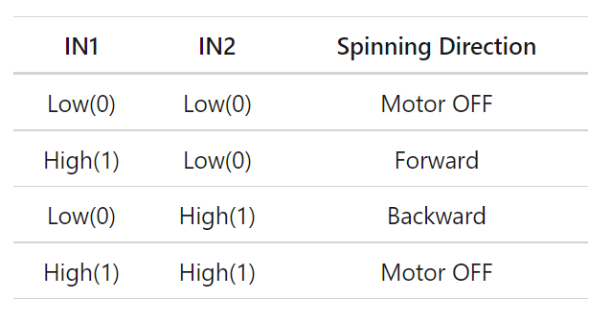
L293D Motor Driver Control Pins
By using the direction control pins, you can control whether the motor rotates forward or backward. These pins actually control the switches of the H-Bridge circuit inside the L293D IC.
The IC has two direction control pins for each channel. The IN1 and IN2 pins control the spinning direction of motor A; While IN3 and IN4 control the spinning direction of motor B.
The spinning direction of the motor can be controlled by applying logic HIGH (5V) or logic LOW (Ground) to these inputs. The chart below shows how this is done.

Slide 41
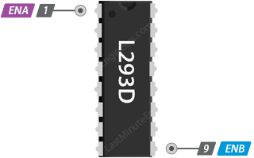
L293D Motor Driver Speed Control Pins
The speed control pins ENA (EN 1,2) and ENB (EN 3,4) are used to turn on/off the motors and control its speed.
Pulling these pins HIGH will cause the motors to spin, while pulling it LOW will stop them. But, with Pulse Width Modulation (PWM), you can actually control the speed of the motors.

Slide 42
Open loop vs closed loop
In an open-loop control system, the control action from the controller is independent of the process variable. An example of this is a central heating boiler controlled only by a timer. The control action is the switching on or off of the boiler. The process variable is the building temperature. This controller operates the heating system for a constant time regardless of the temperature of the building. (Fig 1A)

Slide 43
Open loop vs closed loop
In a closed-loop control system, the control action from the controller is dependent on the desired and actual process variable. In the case of the boiler analogy, this would utilise a thermostat to monitor the building temperature, and feed back a signal to ensure the controller output maintains the building temperature close to that set on the thermostat.
A closed loop controller has a feedback loop which ensures the controller exerts a control action to control a process variable at the same value as the setpoint. For this reason, closed-loop controllers are also called feedback controllers. (Fig 1B)

Slide 44
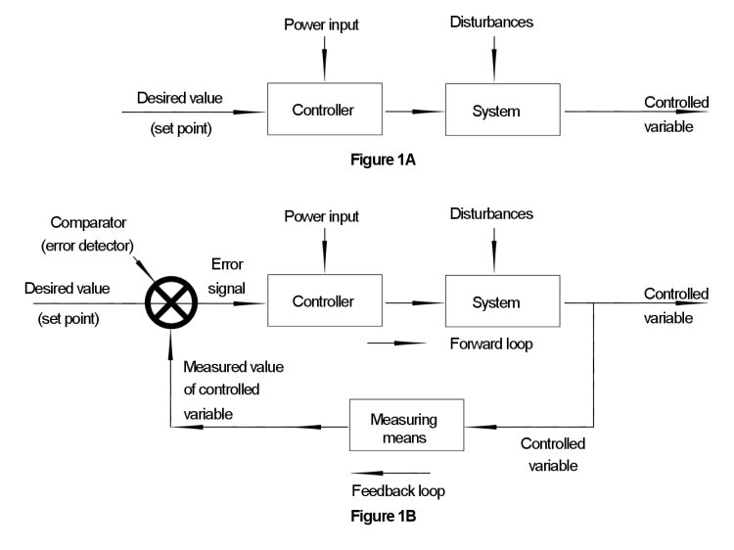
Open loop vs closed loop
Source: https://www.pesquality.com/blog/open-loop-and-closed-loop-systems

Slide 45
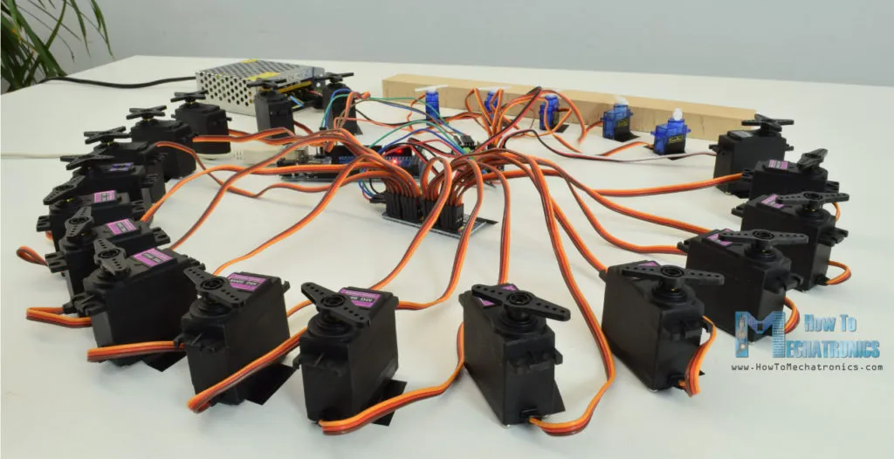
Closed loop: Servo motors

Slide 46
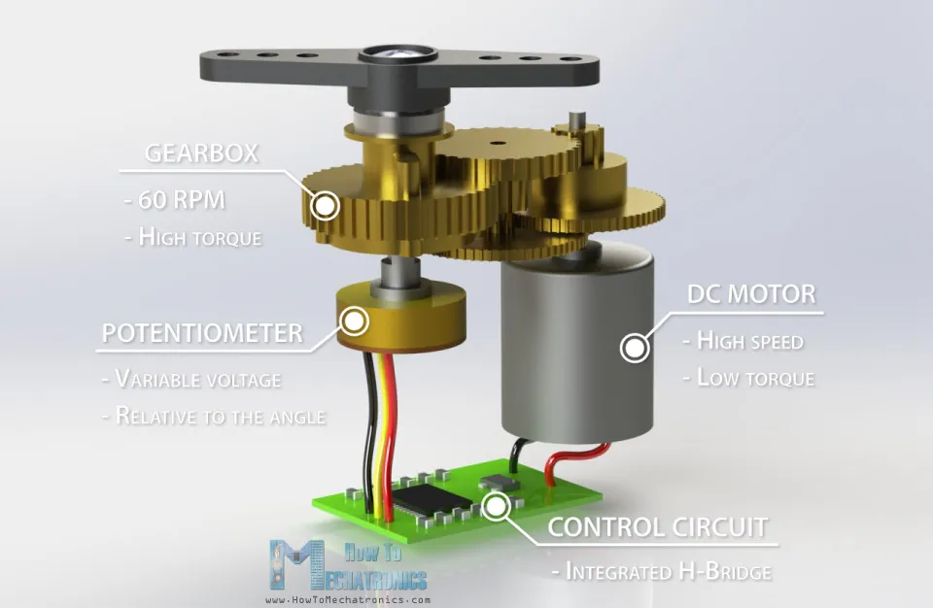
Servo motors
What is a servomotor?

Slide 47
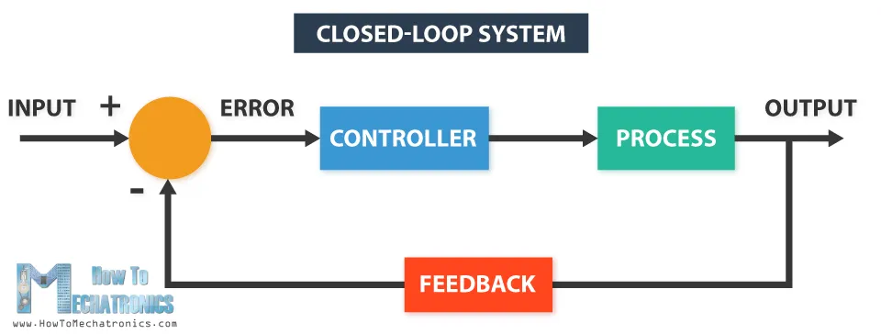
Servo motors
What is a servomotor?
A servo motor is a closed-loop system that uses position feedback to control its motion and final position. There are many types of servo motors and their main feature is the ability to precisely control the position of their shaft.

Slide 48
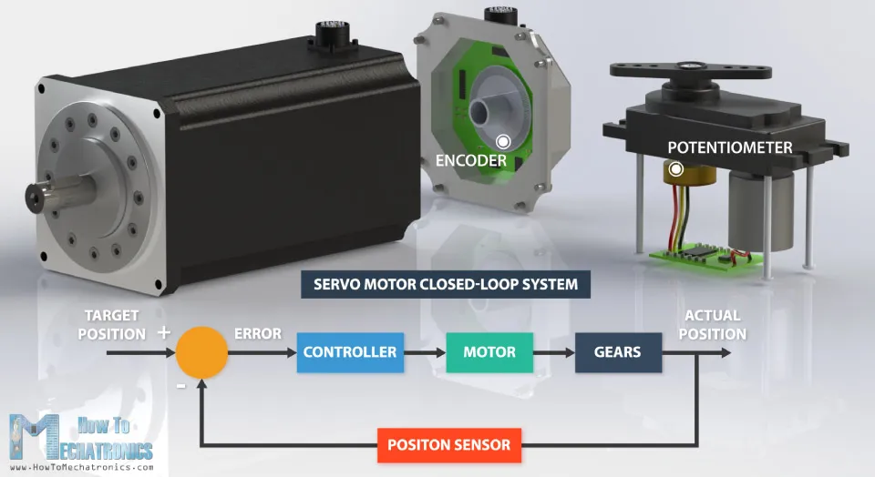
Servo motors: How do they work?
In industrial type servo motors the position feedback sensor is usually a high precision encoder, while in the smaller RC or hobby servos the position sensor is usually a simple potentiometer. The actual position captured by these devices is fed back to the error detector where it is compared to the target position. Then according to the error the controller corrects the actual position of the motor to match with the target position.

Slide 49
Servo motors: How do they work?
There are four main components inside of a hobby servo, a DC motor, a gearbox, a potentiometer and a control circuit. The DC motor is high speed and low torque but the gearbox reduces the speed to around 60 RPM and at the same time increases the torque.
The potentiometer is attached on the final gear or the output shaft, so as the motor rotates the potentiometer rotates as well, thus producing a voltage that is related to the absolute angle of the output shaft. In the control circuit, this potentiometer voltage is compared to the voltage coming from the signal line. If needed, the controller activates an integrated H-Bridge which enables the motor to rotate in either direction until the two signals reach a difference of zero.
Source for most stuff: https://howtomechatronics.com/how-it-works/how-servo-motors-work-how-to-control-servos-using-arduino/

Slide 50
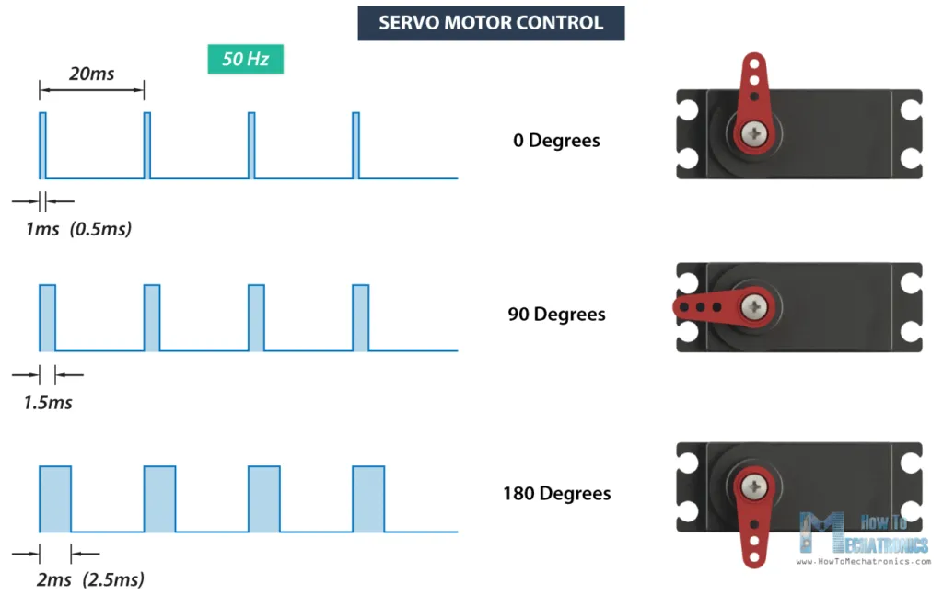
Servo motors: How do they work?
A servo motor is controlled by sending a series of pulses through the signal line. The frequency of the control signal should be 50Hz or a pulse should occur every 20ms. The width of pulse determines angular position of the servo and these type of servos can usually rotate 180 degrees (they have a physical limits of travel).

Slide 51
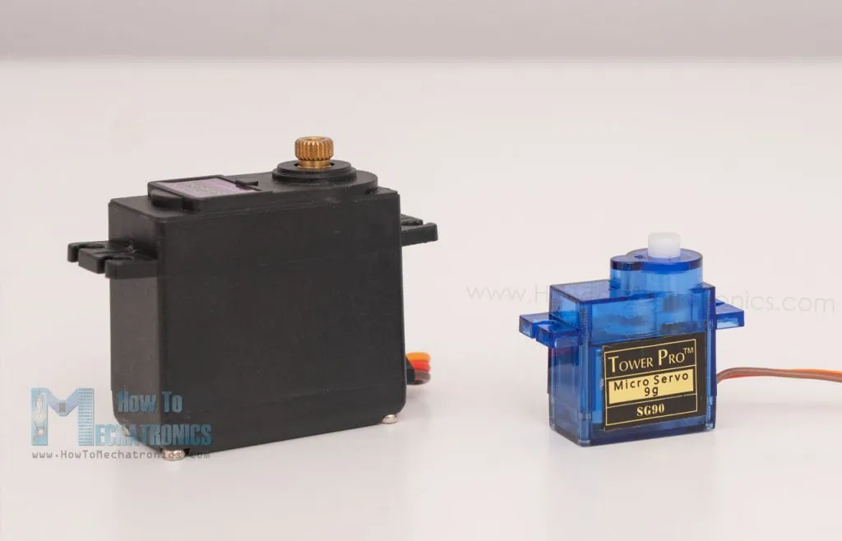
Servo motors: Popular hobby models
Here are the two most popular servo models among makers, the SG90 Micro Servo and the MG996R.

Slide 52
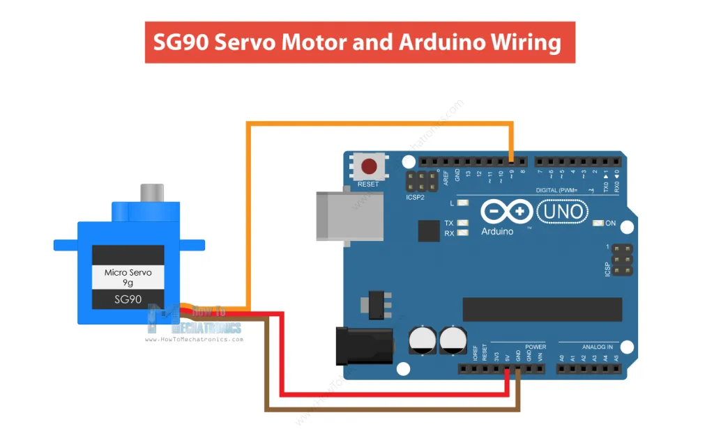
Servo motors: arduino control
We need a single PWM pin to control a servo.
For small ones, we can power them directly from Arduino.
Remember that using the Servo library automatically disables PWM functionality on PWM pins 9 and 10 on the Arduino UNO and similar boards.

Slide 53
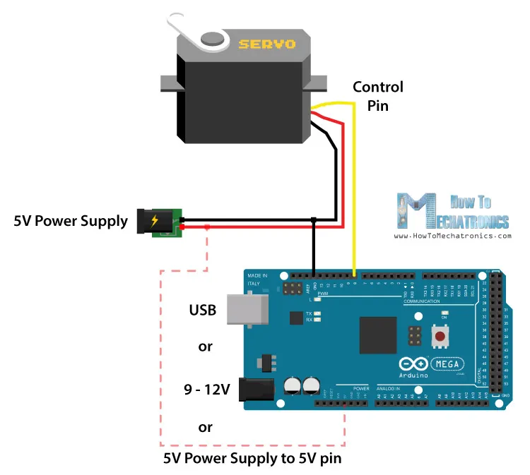
Servo motors: arduino control
We need a single PWM pin to control a servo.
Bigger servos need a separate power supply. Always remember that you need common ground between the power supply and the control board (arduino).

Slide 54
Closed loop: Servo motors

Slide 55
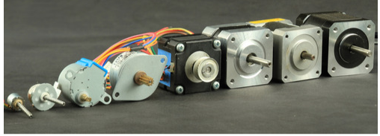
Open loop: Stepper motors

Slide 56
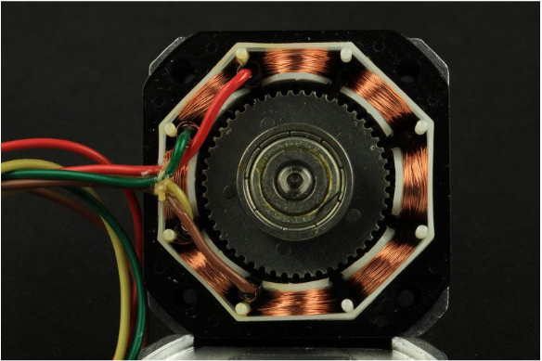
Stepper motors
What is a stepper motor?

Slide 57
Stepper motors
What is a stepper motor?
Remember the brushless DC?

Slide 58
Stepper motors
What is a stepper motor?
Stepper motors are DC motors that move in discrete steps. They have multiple coils that are organized in groups called "phases". By energizing each phase in sequence, the motor will rotate, one step at a time.
Fundamentally, they are the same with brushless DC, but made for a very different application.

Slide 59
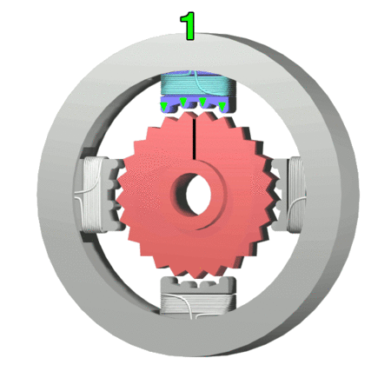
Stepper motors
How does a stepper motor work?

Slide 60
Stepper motors
How does a stepper motor work? (simplified unipolar stepper motor example)
Frame 1: The top electromagnet (1) is turned on, attracting the nearest teeth of the gear-shaped iron rotor. With the teeth aligned to electromagnet 1, they will be slightly offset from right electromagnet (2).
Frame 2: The top electromagnet (1) is turned off, and the right electromagnet (2) is energized, pulling the teeth into alignment with it. This results in a rotation of 3.6° in this example.
Frame 3: The bottom electromagnet (3) is energized; another 3.6° rotation occurs.
Frame 4: The left electromagnet (4) is energized, rotating again by 3.6°. When the top electromagnet (1) is again enabled, the rotor will have rotated by one tooth position; since there are 25 teeth, it will take 100 steps to make a full rotation in this example.

Slide 61
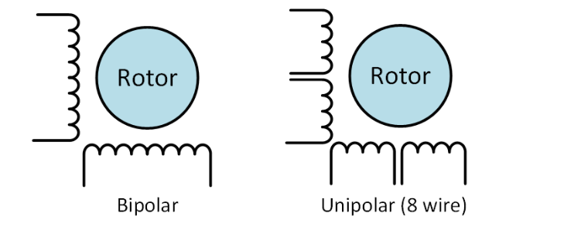
Stepper motors
Types of stepper motors: unipolar vs bipolar
Stepper motor may have any number of coils. But these are connected in groups called "phases". All the coils in a phase are energized together

Slide 62
Stepper motors
Unipolar drivers, always energize the phases in the same way. One lead, the "common" lead, will always be negative. The other lead will always be positive. Unipolar drivers can be implemented with simple transistor circuitry. The disadvantage is that there is less available torque because only half of the coils can be energized at a time.
Stepper motor may have any number of coils. But these are connected in groups called "phases". All the coils in a phase are energized together
Bipolar drivers use H-bridge circuit to actually reverse the current flow through the phases. By energizing the phases with alternating the polarity, all the coils can be put to work turning the motor. A two phase bipolar motor has 2 groups of coils. A 4 phase unipolar motor has 4. A 2-phase bipolar motor will have 4 wires - 2 for each phase. Some motors come with flexible wiring that allows you to run the motor as either bipolar or unipolar

Slide 63
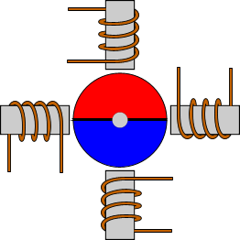
Stepper motors types by construction
Permanent Magnet Stepper Motor (PM)
The first and most basic type of stepper motors is the Permanent Magnet (PM). The rotor of the PM motor carries a permanent magnet with 2 or more poles, in a shape of disk.. The stator coils will attract or repulse the permanent magnet on the rotor and will generate the torque.
PM stepper motors have usually step angle from 45 to 90 degrees.

Slide 64
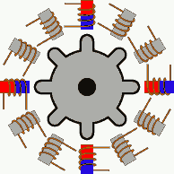
Stepper motors types by construction
Variable Reluctance Stepper Motor (VR)
The VR motor does not have a permanent magnet on the rotor. Instead, the rotor is made of soft iron, and performs a toothed disk like a gear. The stator has more than 4 coils. The coils are energized in opposite pairs, and will attract the rotor.
VR stepper motors have usually step angle from 5 to 15 degrees.

Slide 65
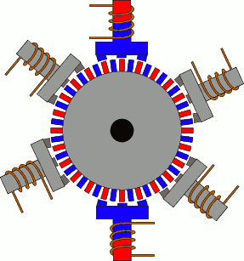
Stepper motors types by construction
Hybrid Stepper Motor
The hybrid stepper motors are named so, because they combine the characteristics from both VR and PM stepper motors. They have excellent hold and dynamic torque, and very small step angles, from 0.9 to 5 degrees, making them highly accurate. Their mechanical parts can rotate at high speeds relatively to the other stepper motor types. This is the type of motor used for high end CNC and robots. The major disadvantage is the cost.
Don't try to follow the coils to see how it works. Just focus on one coil and wait.

Slide 66
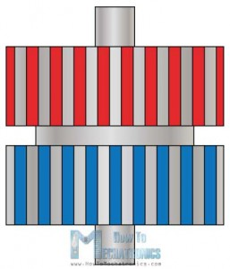
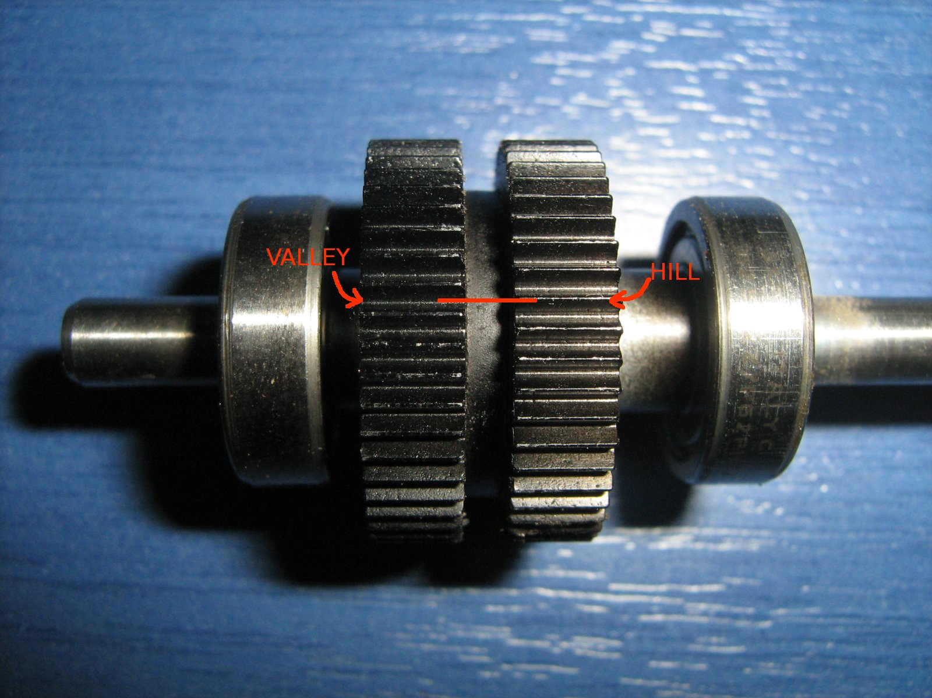
Stepper motors types by construction
Hybrid Stepper Motor

Slide 67
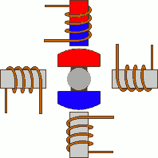
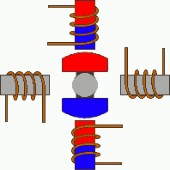
Stepper motors: microstepping
Wave drive or Single-Coil Excitation
The first way is the one described previously. This is called Single-Coil Excitation, and means that only one coil is energized each time. This method is rarely used, generally when power saving is necessary. It provides less than half of the nominal torque of the motor, therefore the motor load cannot be high.
Full step drive
The second and most often used method, is the Full step drive. In this method, the coils are energized in pairs. According to the connection of the coils (series or parallel) the motor will require double the voltage or double the current to operate that needs when driving with Single-Coil Excitation. Yet, it produces 100% the nominal torque of the motor.

Slide 68
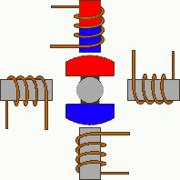

Stepper motors: microstepping
Half stepping
This is a very interesting way to achieve double the accuracy of a positioning system, without changing anything from the hardware! According to this method, all coil pairs can be energized simultaneously, causing the rotor to rotate half the way as a normal step. This method can be single-coil or two-coil excitation as well.

Slide 69


Stepper motors: microstepping
Microstepping
Microstepping is the most common method to control stepper motors nowadays. The idea of microstepping, is to power the coils of the motor NOT with pulses, but with a waveform similar to a sin waveform. This way, the positioning from one step to the other is smoother, making the stepper motor suitable to be used for high accuracy applications such as CNC positioning systems. Also, the stress of the parts connected on the motor, as well as the stress on the motor itself is significantly decreased. With microstepping, a stepper motor can rotate almost continuous, like simple DC motors.

Slide 70
Stepper motors: drivers
Remember transistors and H-bridges?
We can easily control the Unipolar stepper motor with transistors while controlling the Bipolar motors with Dual H-bridge drivers. Why is that?

Slide 71


Stepper motors: drivers
ULN2003
Is an array of seven NPN Darlington transistors
Darlington transistor (also known as Darlington pair) achieves very high current amplification by connecting two bipolar transistors in direct DC coupling so the current amplified by the first transistor is amplified further by the second one. The resultant current gain is the product of those of the two component transistors:

Slide 72

Stepper motors: drivers
L293D
L293D is a typical Motor driver or Motor Driver IC which allows DC motor to drive on either direction. L293D is a 16-pin IC which can control a set of two DC motors simultaneously in any direction.
In the case of a bipolar stepper, instead of controlling 2 DC motors, we will use them to control the two phases

Slide 73
Attendance check

